Slide 1
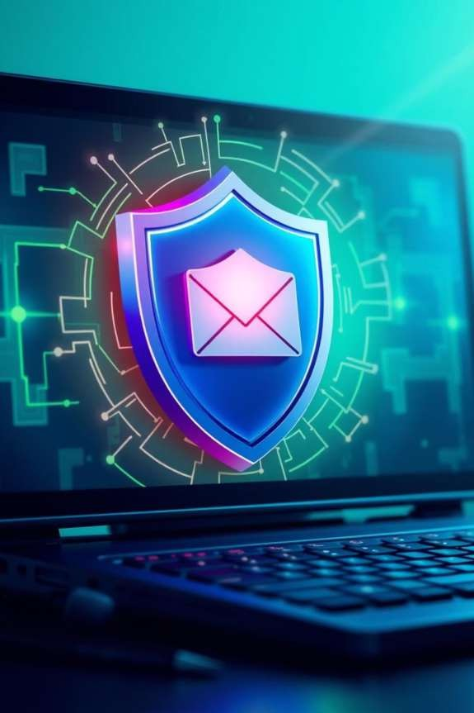
Phis hing Attacks : Stay Safe Online
Understanding and recognizing phishing attacks is crucial for online safety. This presentation will equip you with the knowledge and tools to protect yourself from these deceptive threats.
by Vedika Fulzele

Slide 2
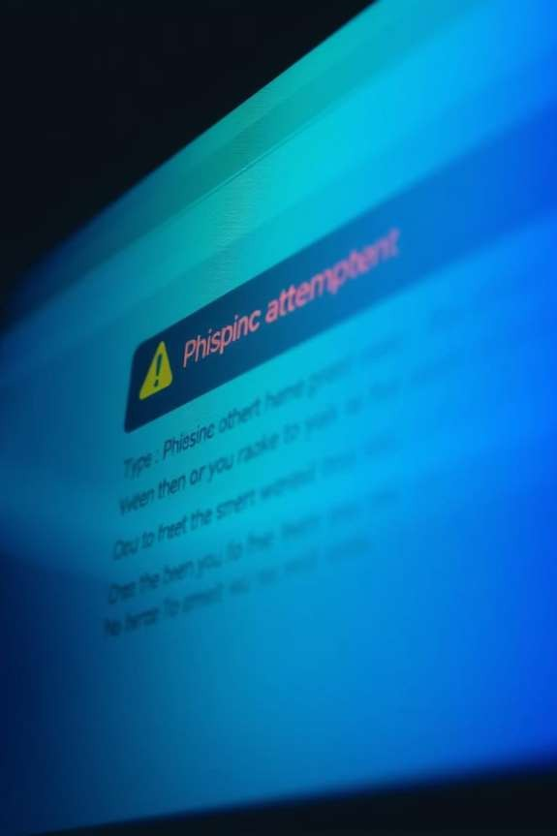
Recognizing Phishing Emails
Suspicious Sender
Check the sender's email address carefully for inconsistencies.
Urgent Language
Beware of emails demanding immediate action or threatening
consequences.
Generic Greetings
Phishing emails often use generic greetings instead of your name.
Poor Grammar
Look for typos, grammatical errors, or awkward phrasing.

Slide 3
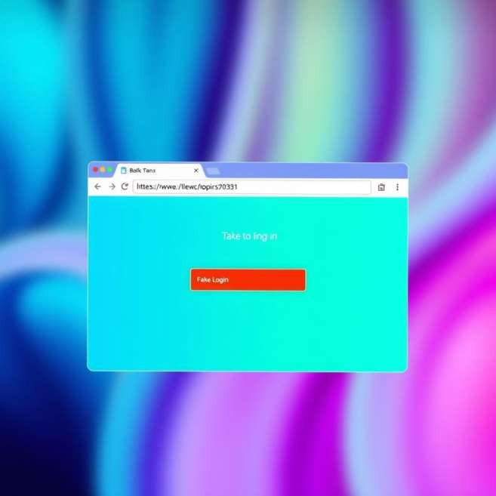
Identifying Fake Websites
URL Mismatch
Always verify the website's URL. Look for subtle misspellings or unusual domains.
No HTTPS
Legitimate websites use HTTPS for secure connections. Check for the padlock icon.
Poor Design
Fake sites often have low-quality graphics, inconsistent
branding, or missing content.

Slide 4





S ocial E ngineering Tac tics
Pretexting
Attackers create a fabricated scenario to trick you into divulging
information.
Baiting
Offering something enticing (e.g., free downloads) to lure victims.
Quid Pro Quo
Promising a service or benefit in exchange for information.
Impers onation
Attackers pretend to be a trusted entity (bank, IT support, etc.).

Slide 5
Best Practices to Avoid Falling Victim
Hover Over Links
Before clicking, hover your mouse over links to see the actual URL.
Verify Sender
Always double-check the sender's identity before clicking links or
opening attachments.
Enable 2FA
Two-factor authentication adds an extra layer of security to your accounts.
Use Strong Passwords
Create unique, complex passwords and use a password manager.

Slide 6
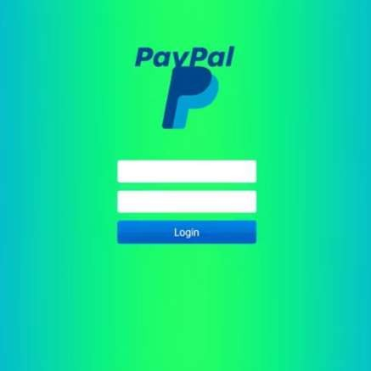
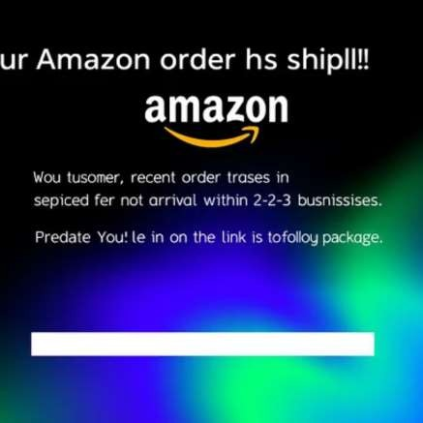
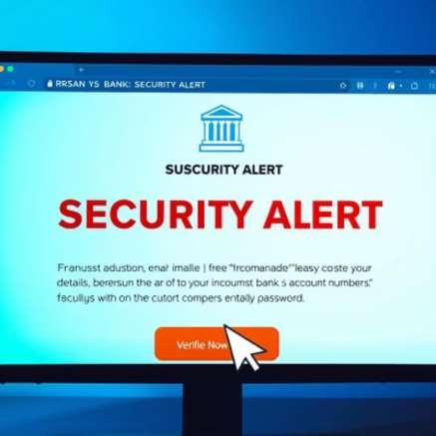
R eal-World Phis hing E xamples
Phishing attacks often mimic legitimate brands. These examples show how convincing they can be, highlighting the
importance of vigilance.

Slide 7



Interactive Quiz: Test Your Knowledge
Test your ability to spot phishing attempts with our interactive quiz.
Can you identify the red flags?

Slide 8

Key Takeaways & Next Steps
Stay Vigilant
Always be suspicious of unsolicited emails and messages.
Educate Yourself
Continuously learn about new phishing tactics and security measures.
Report Incidents
Report any suspicious activity to your IT department or relevant authorities.

